Slide 1
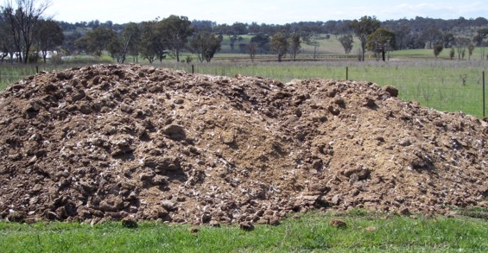
Poultry Litter Management
Richard K. Koelsch, Bio. Systems Engr. and Animal Science, University of Nebraska

Slide 2
Questions for Today’s Discussion
How is poultry litter managed?
How much land is needed to manage the N and P from a broiler house?
How might litter be integrated into a fertility plan?
What fields will benefit the most from poultry litter?
How do I plan litter application to avoid neighbor nuisances?

Slide 3
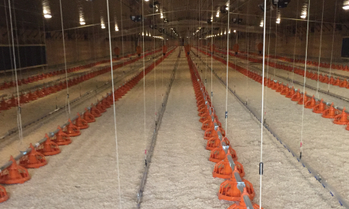
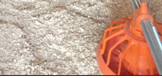
How is poultry litter managed?

Slide 4
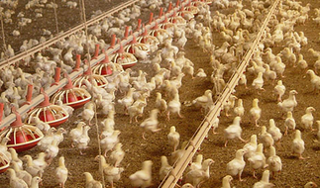
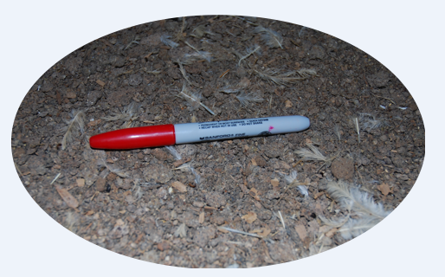

Slide 5
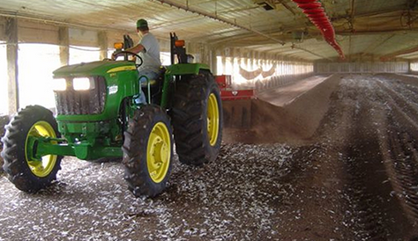
Windrow for composting

Slide 6
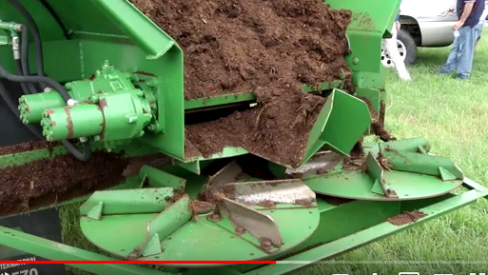
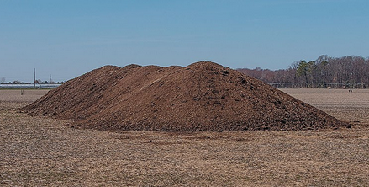
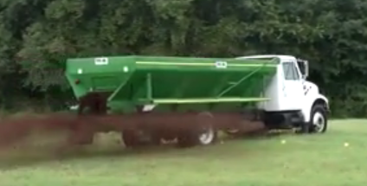
Temporarily stockpiled and land applied

Slide 7
How much land is needed to manage nutrients from a broiler house?
Litter and cake production: 1.3 to 1.5 tons per 1,000 birds
N & P₂O₅, production is about 90 & 70 lbs per 1,000 birds
Land Required (acres)
4 Houses 8 Houses
200 bu/ac continuous corn:
N Utilization 40 80
P Utilization 180 370
200 bu/ac corn and 65 bu/ac soybean rotation:
N Utilization 40 80
P Utilization 200 410

Slide 8
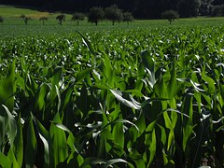
Integrating litter into a fertility plan?
What Is Our Goal?
Manure
Balancing field Imports with crop requirements:
Balance N annually.
Balance P over 3 to 5 year period
Limit Edge of Field Loss
Crop
Fertilizer
Other N Sources

Slide 9
Average nutrient composition of poultry manure (wet basis)
Maximizing Poultry Manure Use Through Nutrient Management Planning, Casey W. Ritz and William C. Merka UGA Extension Poultry Scientists. December 2013.

Slide 10
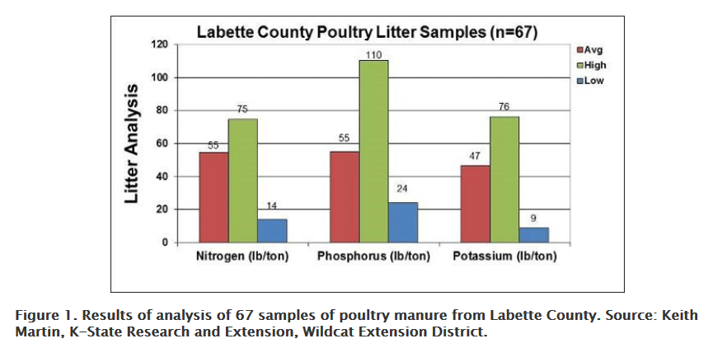
Nutrient availability in poultry manure. Dorivar Ruiz Diaz, Doug Shoup, Peter Tomlinson. Kansas State University Extension. Dec. 2016

Slide 11
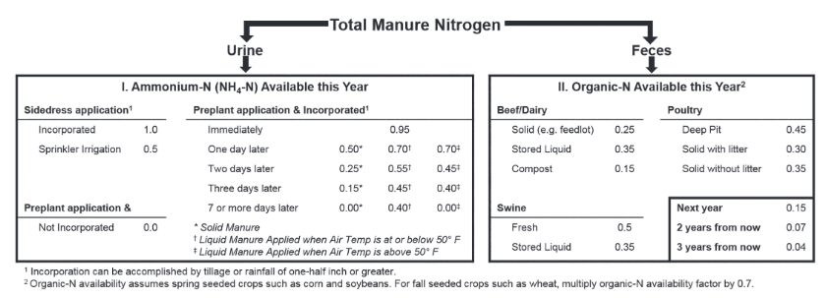
Nitrogen Availability from manures
Determining Crop Available Nutrients from Manure. Charles Shapiro, et al., Nebguide G1335

Slide 12
Preferred application rate (200 bu/ac corn requiring 160 lb N and 66 lb P/ac)
N Rate: 10 ton litter/ac
540 lb P₂O₅/ac or 9 years of P for
corn/soybean rotation
50% N Rate: 5 ton liter/ac
250 lb P₂O₅/ac or 4 years of P for
corn/soybean rotation
P Rate: 1.2 ton liter/ac
20 lb litter N/ac plus 140 lb inorganic N/ac
Assume liter is surface applied and not incorporated.
Preferred Rate: Compromise of two

Slide 13
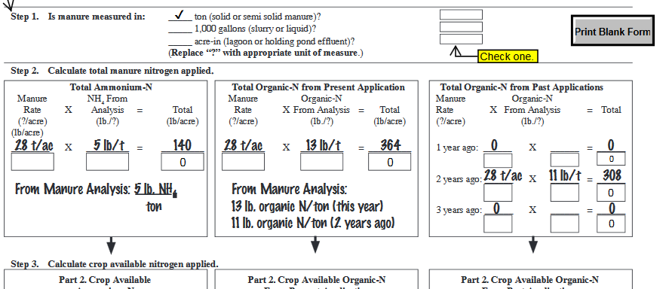
Worksheet for Calculations (Nebguide G1335)

Slide 14
What fields will benefit the most from poultry litter?
Lower Estimate¹
$ 35 per ton
Higher Estimate²
$58 per ton
1. 2017s fertilizer prices,
2. 2017 fertilizer prices + value for potash + 5% yield increase

Slide 15
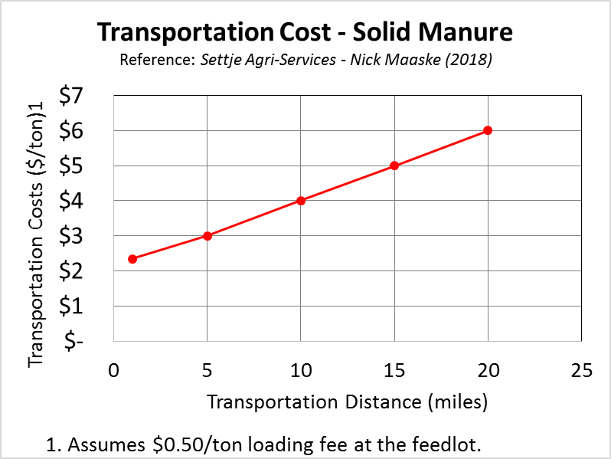
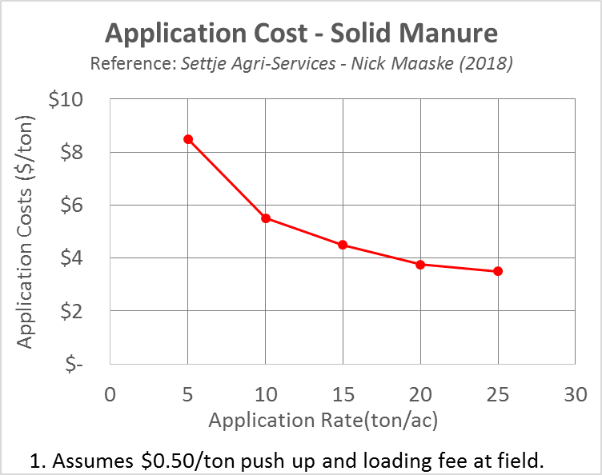
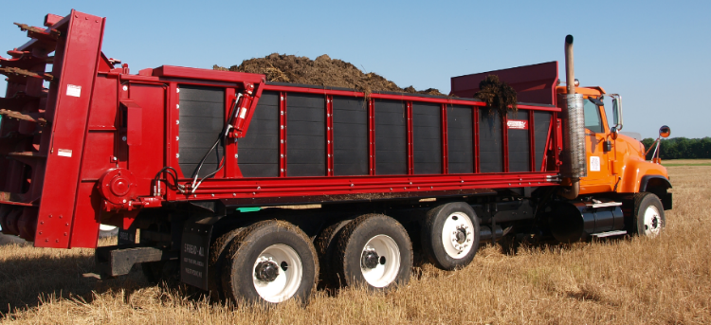
Commercial Hauler Transportation & Application Costs: Solid Manures
Haul 20 miles - $6/ton
Poultry Litter - $9/ton
Notes:
Solid manure transportation
$0.50/ton to load
1 mile - $1.85/ton
5 miles - $2.50/ton
10 miles - $3.50/ton
15 miles - $4.50/ton
20 miles - $5.50/ton
$0.50/ton to push up stockpile at field if needed
Solid manure application
5 ton/acre rate $8.00/ton
10 ton/acre rate $5.00/ton
15 ton/acre rate $4.00/ton
20 ton/acre rate $3.25/ton
25 ton/acre rate $3.00/ton
The side dumps are usually about 25 – 28 ton capacity. (can vary depending upon moisture content of the manure)
The spreaders are anywhere from 35 – 50 ton capacity. (can vary depending upon moisture content of the manure)
The loaders can vary from 3 -5 yard buckets.

Slide 16
Which Fields Win from Manure’s Fertility Value?
Phosphorus. Target fields/crops:
With < 20 PPM P Bray
Benefitting high soil P such as wheat.
With higher P uptake (corn silage, irrigated alfalfa)
Most manure applications deliver P needs for multiple years - Delay returning to the same field.

Slide 17
Which Fields Win from Manure’s Fertility Value?
Target fields/crops:
Potassium
Nitrogen (apply ahead of non-legume crops)

Slide 18
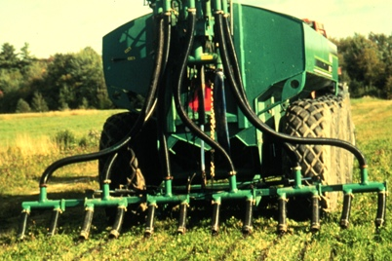
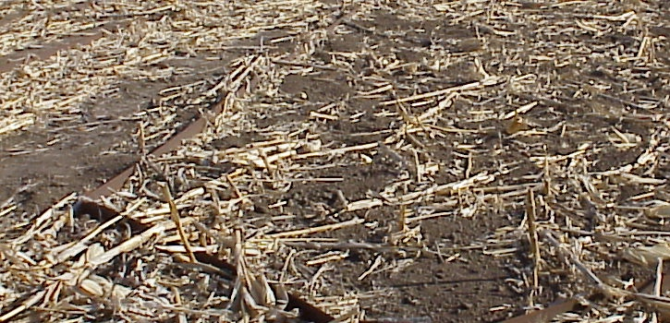
Organic matter value of manure
Manure
Soil
Microbial Activity
Multiple Soil & Crop Benefits
Notes:
Manure also is good for the soil. Because of the organic matter, by that I mean undigested food particles and bedding, manure improves water movement into the ground rather than allowing that water to run off. And when runoff is decreased, so is erosion.
Carbon is an essential component of a healthy soil. When manure is added to the soil, it is quickly colonized by millions of bacteria. These organisms derive their energy and nutrients from the organic matter. During the decomposition of the organic matter, bacteria produce large quantities of polysaccharides. These are the “sticky glue” that allows soils to form aggregates.
The end result is greater moisture infiltration into the soil, less runoff and less erosion.

Slide 19
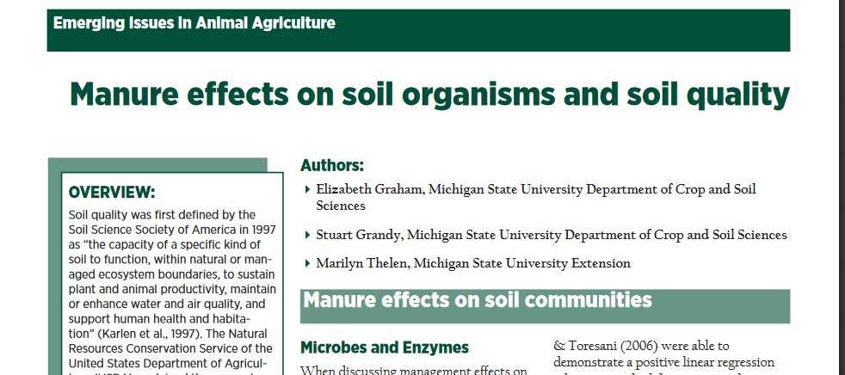
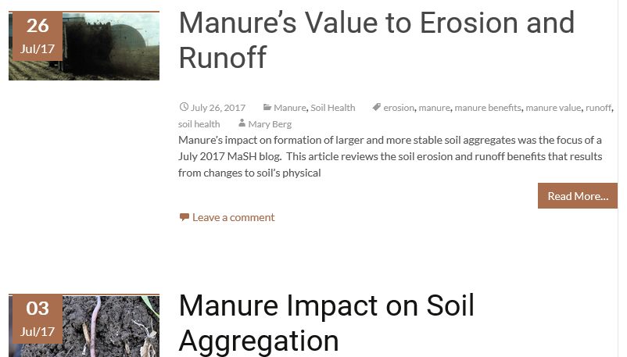
Organic matter value of manure
Notes:
Manure also is good for the soil. Because of the organic matter, by that I mean undigested food particles and bedding, manure improves water movement into the ground rather than allowing that water to run off. And when runoff is decreased, so is erosion.
Carbon is an essential component of a healthy soil. When manure is added to the soil, it is quickly colonized by millions of bacteria. These organisms derive their energy and nutrients from the organic matter. During the decomposition of the organic matter, bacteria produce large quantities of polysaccharides. These are the “sticky glue” that allows soils to form aggregates.
The end result is greater moisture infiltration into the soil, less runoff and less erosion.

Slide 20
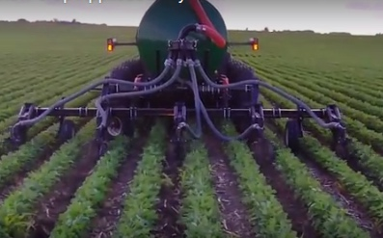
Which Fields Win from
Manure’s Organic Value?
Target Fields with:
Finer texture soils.
Lower organic matter.
Crusting
Low biological activity - fewer earthworms
Fields commonly experiencing ponding and drown out.

Slide 21
How do I plan litter application to avoid neighbor nuisances?
Timing Manure Application to Avoid Neighbor Nuisances
https://water.unl.edu/article/animal-manure-management/timing-manure-application-avoid-neighbor-nuisances

Slide 22
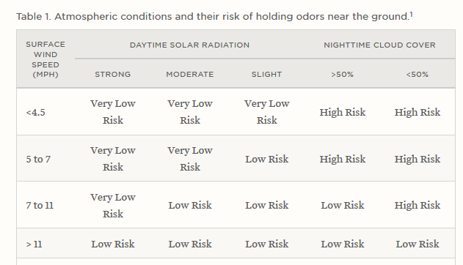

Slide 23
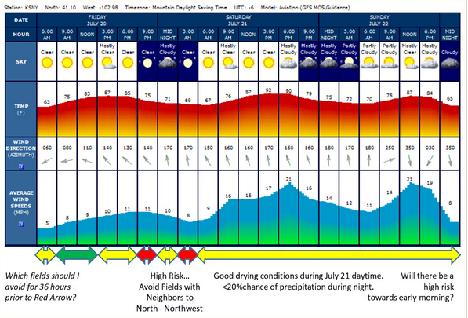
Avoiding Nuisance Odors: Review 48-hour weather forecast
Avoid spreading on fields with neighbors to north
Low Odor Risk Day for spreading manure

Slide 24
Questions & Comments
Richard K. Koelsch, University of Nebraska, rkoelsch1@unl.edu, 402/472-3935

Slide 25
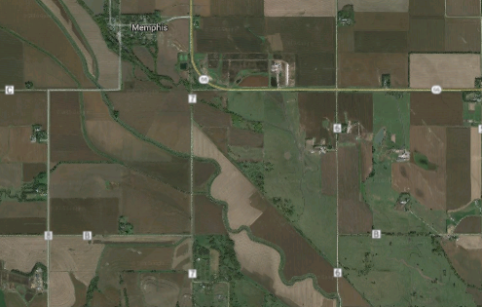
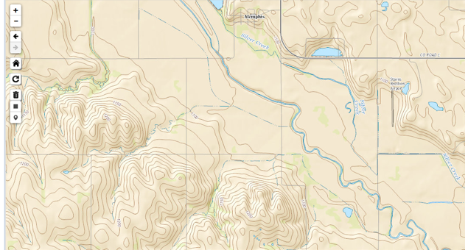
Setbacks & Grass Buffers Needed?
???

Slide 26
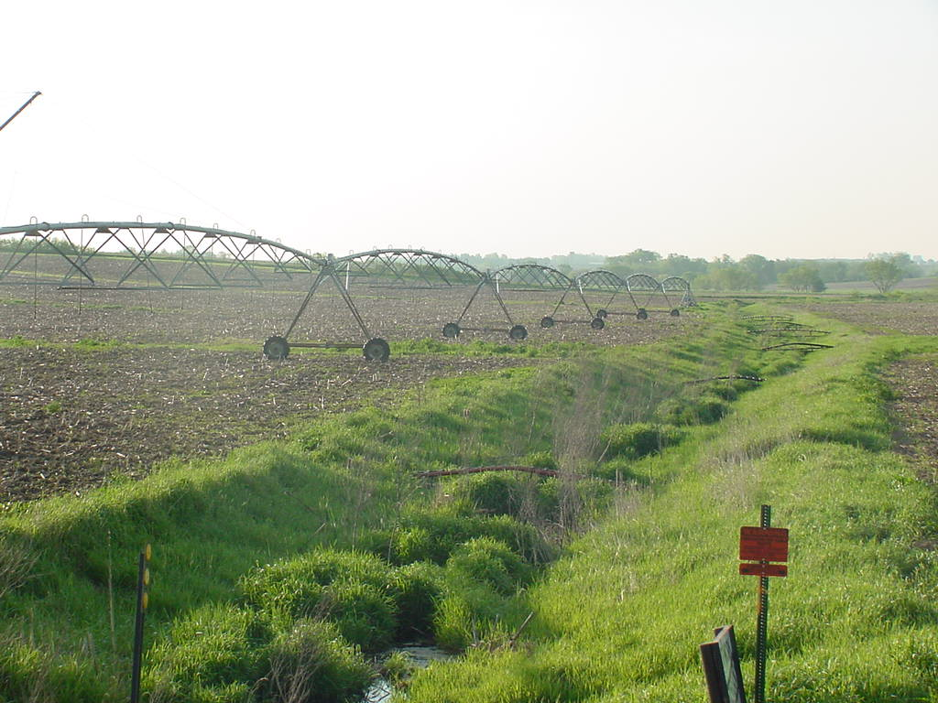
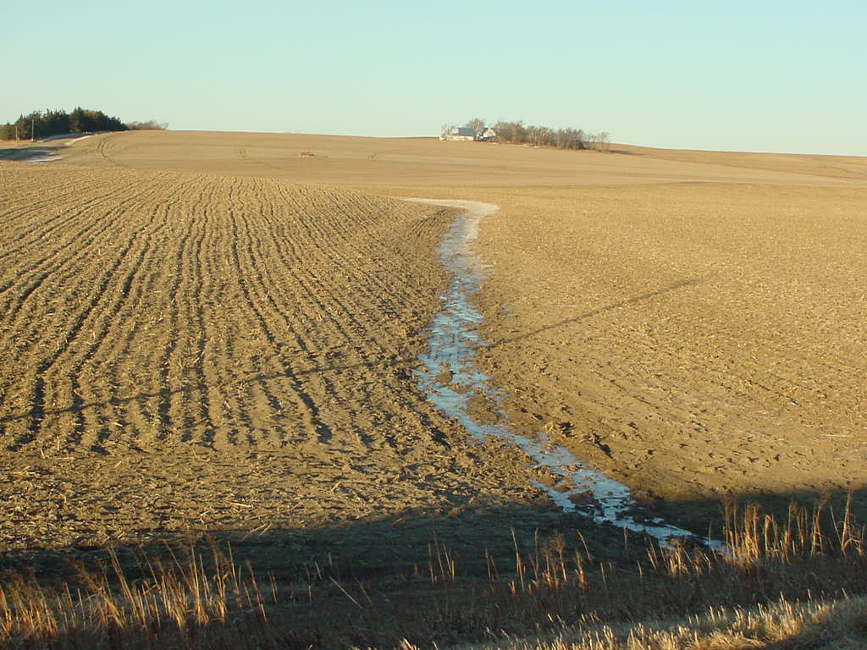
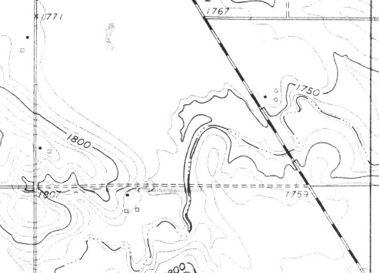
Buffers or Setbacks
Title 130: Manure is “not to be applied within 100’ of down-gradient surface waters, tile intakes, sinkholes, well heads, or other conduits to surface water”. 35 foot grassed buffer is option to 100 foot no application zone.
?
?

Slide 27
Take Home Message – N & P Exports
Our ability to recycle manure nutrients & carbon is a Nebraska’s advantage.
Help producer answer:
How many acres are needed to recycle N & P?
Will setback/buffer requirements eliminate some fields from consideration?

Slide 28
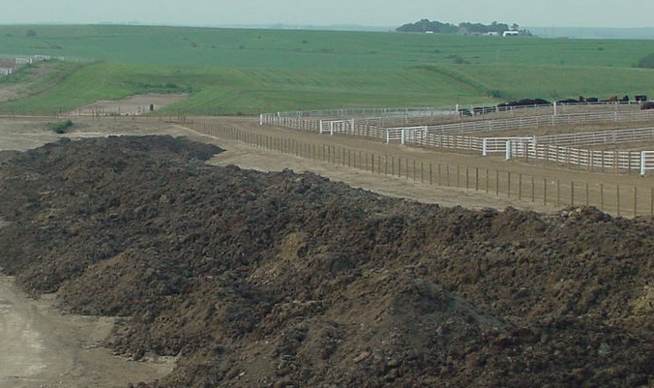
What Principles Should Guide Nutrient Plans of the future?
Minimize environmental impact of nutrients
Satisfy public (& regulatory) expectations
Document farm’s sustainability?
Measurable metrics?
Efficient use of inputs?
Continuous improvement?
Communicate to consumer?

