Slide 1
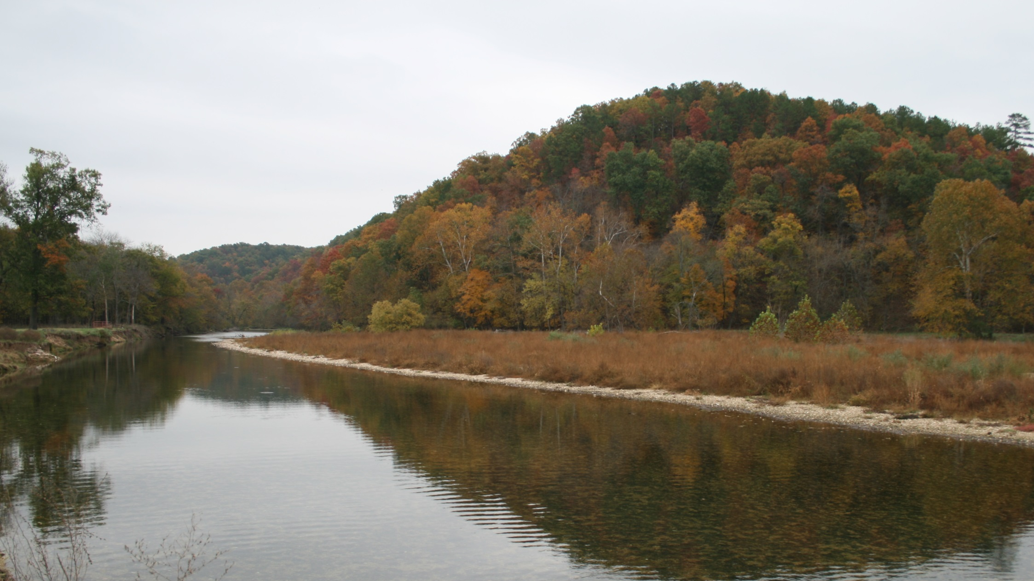
Livestock and Poultry Production:
Long and Short term Monitoring For Water Quality
POULTRY INTEREST TEAM WEBINAR SERIES
Dr. Daniel Snow,
Research Professor and Laboratory Director
Nebraska Water Center
University of Nebraska
Dr. Aaron Mittelstet
Assistant Professor
Biological Systems Engineering
University of Nebraska-Lincoln
October 16, 2018

Slide 2
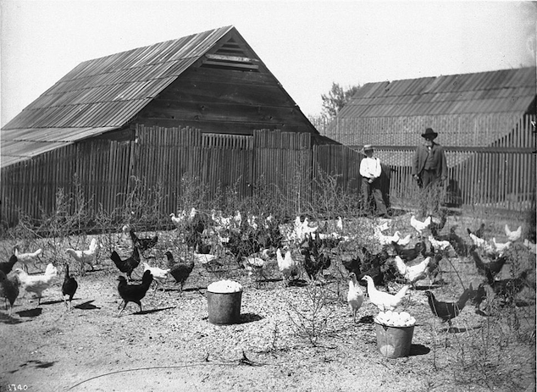
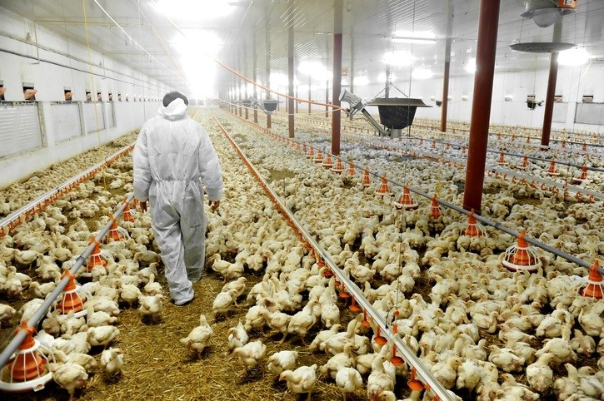
Changing Approaches to Livestock Production
Chickens in an outdoor pen on a chicken ranch in California in 1920
https://www.thehappychickencoop.com/a-history-of-chickens/
https://www.feednavigator.com/Article/2018/09/06/Tyson-The-role-of-eubiotics-in-antibiotic-free-poultry-production

Slide 3
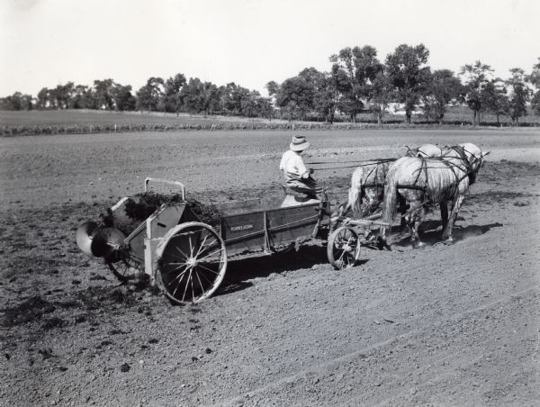
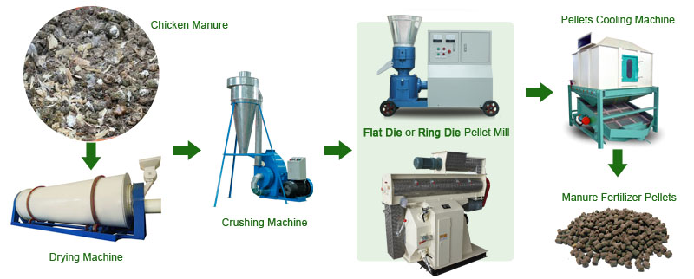
Changing face of manure management
Horse-Drawn Manure Spreader
https://www.wisconsinhistory.org/Records/Image/IM74922
Chicken Manure Fertilizer Pellet Making Machine
http://www.pelletmillsolution.com/biomass-materials/chicken-manure-fertilizer-pellet-making-.html

Slide 4
Water quality concerns
Management of farm wastewater and effluents
Increased losses of nutrients (N&P)
Pharmaceuticals, pesticides, metals
Groundwater impacts (N-related)
Surface water impacts (P-related)
Hooda, P. S., Edwards, A. C., Anderson, H. A., & Miller, A. (2000). A review of water quality concerns in livestock farming areas. Science of the Total Environment, 250(1-3), 143-167.

Slide 5
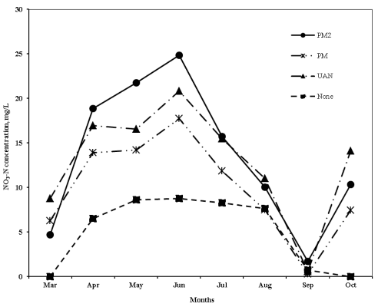
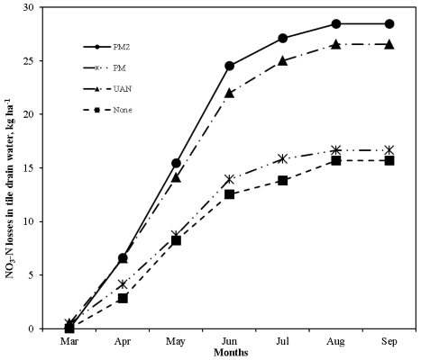
Subsurface nutrient losses
PM2 = 336 kg N/ha; PM = 168 kg N/ha; UAN = 168 kg N/ha
Increased nutrient losses mostly related to combined use of manure and mineral fertilizer or overapplication of manure beyond crop requirements
Losses most likely to occur early in growing season
Lowest N loss under agronomic rate of total N as poultry manure (75% available N)
Q. Nguyen, H.; S. Kanwar, R.; L. Hoover, N.; Dixon, P.; Hobbs, J.; Pederson, C.; L. Soupir, M. (2013) Long-Term Effects of Poultry Manure Application on Nitrate Leaching in Tile Drain Water. Transactions of the ASABE 56 (1), 91-101.

Slide 6
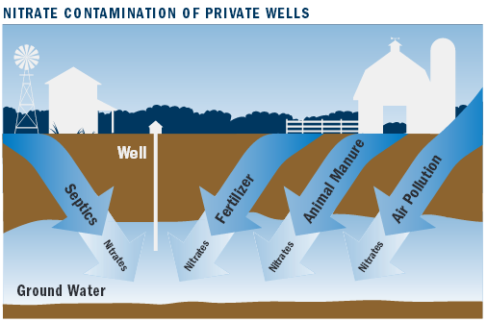
A few studies of groundwater nitrate beneath land fertilized with poultry manure
Monitoring well depth 4.4 to 7.5 meters
107 kg N/ha side dress plus 11-25 tonnes/ha stockpiled manure
(~200-500 kg/ha Total N)
Chesapeake Bay Today
100-120 kg N/ha
Issue traced to sandy soils, shallow water table, too much N
Weil, R. R., Weismiller, R. A., & Turner, R. S. (1990). Nitrate contamination of groundwater under irrigated coastal plain soils. Journal of Environmental Quality, 19(3), 441-448.

Slide 7
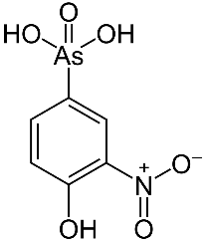
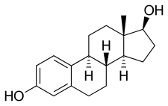
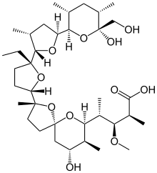
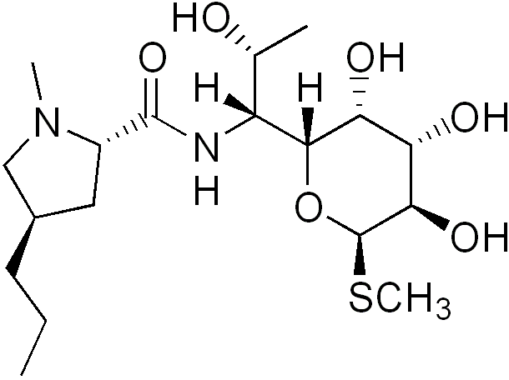
Pharmaceuticals, steroids, antibiotics
Roxarsone fed to broilers up until 2015 led to studies showing elevated arsenic in poultry litter and soils fertilized with litter. Use is now banned by FDA
Steroid hormones occur naturally in litter at ppb concentrations, but tend to be rapidly degraded in the environment
Coccidiostats (monensin, salinomycin) and antibiotics such as tetracyclines, macrolides, lincosamides can be used in poultry production and occur in manure. Most studies suggest little risk to groundwater
Roxarsone
17β-estradiol
Monensin
Lincomycin
Bartelt-Hunt, S., Snow, D. D., Damon-Powell, T., & Miesbach, D. (2011). Occurrence of steroid hormones and antibiotics in shallow groundwater impacted by livestock waste control facilities. Journal of Contaminant Hydrology, 123(3-4), 94-103.
Fisher, D. J.; Yonkos, L. T.; Staver, K. W. (2015) Environmental Concerns of Roxarsone in Broiler Poultry Feed and Litter in Maryland, USA. Environmental Science & Technology 49 (4), 1999-2012.
Jenkins, M. B.; Endale, D. M.; Schomberg, H. H.; Hartel, P. G.; Cabrera, M. L. (2009) 17β-Estradiol and testosterone in drainage and runoff from poultry litter applications to tilled and no-till crop land under irrigation. Journal of Environmental Management 90 (8), 2659-2664.

Slide 8
Illinois River (IRW) and Eucha-Spavinaw Watersheds (ESW)

Slide 9
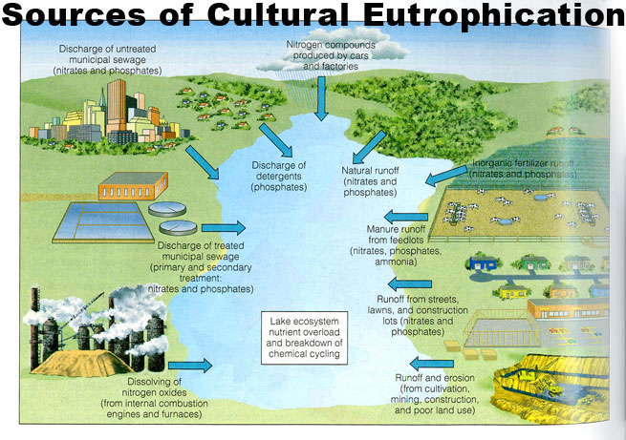
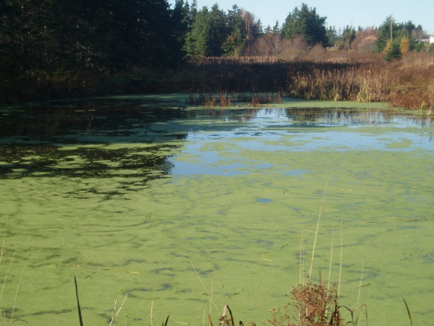
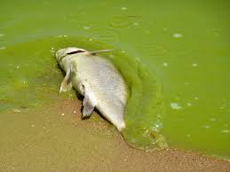
Water Quality Issues in the IRW and ESW
Streams and reservoirs eutrophic
Phosphorus usually limiting nutrient
Waterbodies on 303d list due to:
  Excessive phosphorus
  Dissolved oxygen
  Excessive chlorophyll-a
  Turbidity

Slide 10
Phosphorus Sources
Mittelstet and Storm, 2016
Watershed | # Poulty Houses | # Broilers yr⁻¹ | Poultry Litter (t)
Illinois River Eucha-Spavinaw Proposed | 1,958 508 400 | 150,000,000 40,000,000 32,000,000 | 320,000 80,000 65,000

Slide 11
Legacy Phosphorus
Over 80% of all phosphorus added to the watershed is
stored in the soil, stream system or reservoir
IRW
Mittelstet and Storm, 2016

Slide 12
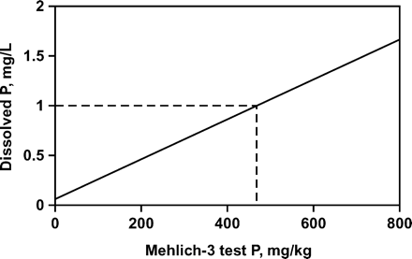
Soil Test Phosphorus

Slide 13
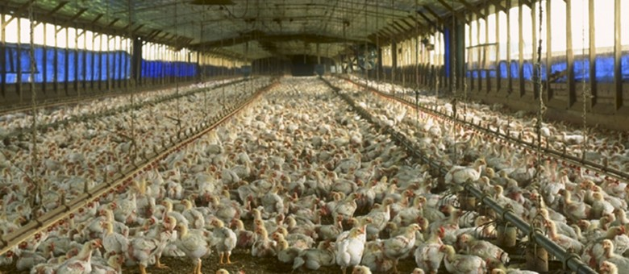
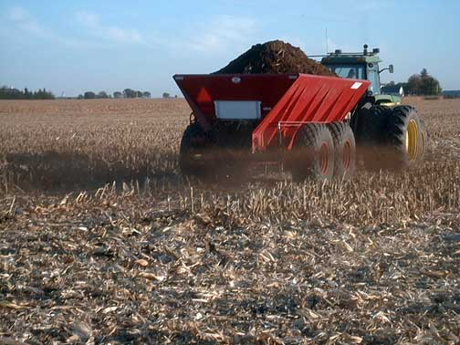
So, what can we do??
Require producers to develop Nutrient Management Plan
Annual testing for soil test phosphorus
Limit poultry litter application near waterbodies and when STP exceeds a pre-defined value

Slide 14
Application Guidelines
Treatment Forage Yield (Tons/Acre
No N 2.77
2 tons/acre litter 3.54
(app. 130 lbs total N/acre
4 tons/acre litter 4.82
(app. 260 lbs Total N/acre
http://poultrywaste.okstate.edu/Publications/files/E-1027%20REV%20061512.pdf
http://pods.dasnr.okstate.edu/docushare/dsweb/Get/Document-2640/PSS-2246web2013.pdf

Slide 15
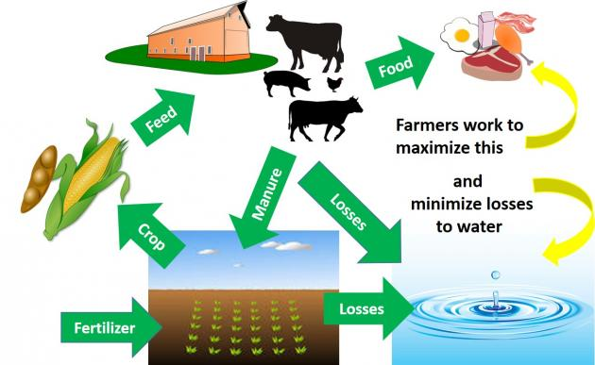
Long and Short term Monitoring For Water Quality
Account for crop nutrient needs and existing sources
Understand long term consequences of manure use
Monitor surface run-off and changing groundwater quality in areas prone to erosion or leaching losses
https://articles.extension.org/pages/74484/water-quality-issues-associated-with-manure

Slide 16

Daniel Snow dsnow1@unl.edu
Aaron Mittelstet amittelstet2@unl.edu
Questions?

