Slide 1
Broiler Litter Facts
Rick Koelsch, rkoelsch1@unl.edu, University of Nebraska-Lincoln, June 2017
How much broiler litter must be managed?
 |  |  | Typical Lab Analysis |  | Approximate Litter Production (lbs or tons/year)¹
Nutrients |  |  | (lbs/wet ton) |  | 1 house | 4 houses | 8 houses
 | Ammonium N |  | 10 |  | 600 | 2,400 | 4,900 | lbs
 | Organic N |  | 55 |  | 3,400 | 13,500 | 27,100 | lbs
 | Phosphate |  | 50 |  | 3,100 | 12,200 | 24,400 | lbs
 | Potash |  | 50 |  | 3,100 | 12,200 | 24,400 | lbs
 | S |  | 15 |  | 900 | 3,700 | 7,300 | lbs
 | Fe |  | 3.2 |  | 200 | 800 | 1,600 | lbs
 | Zn |  | 0.5 |  | - | 100 | 200 | lbs
Moisture |  |  | 71%
Quantity Litter Produced |  |  |  |  | 60 | 240 | 490 | tons
1. Assume 43,650 birds are delivered for processing per flock.
Manure’s
Fertility
Value
 | How much land is needed to use the Nitrogen? Phosphorus?
 |  |  |  | Land Required (acres)
 |  |  |  | 1 house | 4 houses | 8 houses
 | 200 bushel/ac continuous corn
 |  | Nitrogen |  | 10 | 40 | 80
 |  | Phosphorus |  | 50 | 180 | 370
 | 200 bushel/ac corn and 65 bushel/ac soybean rotation
 |  | Nitrogen |  | 10 | 40 | 80
 |  | Phosphorus |  | 50 | 200 | 410
 | How much manure or litter should I apply?
 | Assumptions for Crop Requirement or Removal
 |  | Yield | Estimated N Required |  | P₂O₅ Removal
 |  | (bu/ac) | (lbs/ac)
 | Corn | 200 | 160 |  | 66
 | Soybeans | 65 | 0 |  | 54
 | Wheat | 60 | 70 |  | 32
 | Poultry Manure Application Rate (Tons/Ac)
 |  | N |  | 50% of N | P₂O₅ Removal
 | Corn | 10 |  | 5 | 1.2
 | Soybeans | 0 |  | 0 | 1.0
 | Wheat | 4 |  | 2 | 0.6

Slide 2
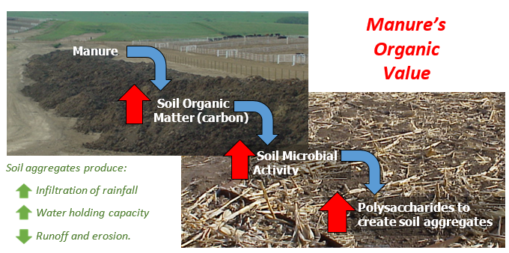
One of Many Values from Manure’s
Organic Matter
Which fields benefit from litter’s organic value? Fields with…
Finer texture soils.
Lower organic matter.
History of tillage.
Tendency to “crust over” with rain.
Ponding and drown out challenges.
Low pH.
Manure Environmental Value?
Reference: Wortmann & Walters
Soil Erosion
Loss (lbs/acre)
Runoff
Volume (acre-inches)
Which fields/crops do I get the greatest $ value from manure nutrients?
Soil P levels of 20 ppm or less.
Crops requiring higher soil P levels…wheat
Crops with higher P removal (corn silage, irrigated alfalfa)
Fields requiring potassium.
Non-legume crops…N value
Credit the manure’s organic nitrogen for 2nd and 3rd crop years after applying manure.
Compost
No
Compost
Compost
No
Compost
Crop years 1999-2001
Residual Effect
(2002-2006)
For more information:
Determining Crop Nutrients from Manure, NebGuide G1335.
Calculating Value of Manure for Crop …, NebGuide G1519
Extension Manure Management Info: http://manure.unl.edu
Manure and Soil Health benefits… https://soilhealthnexus.org/category/manure/
Michigan State Extension pub on “Manure effects on soil…” http://msue.anr.msu.edu/uploads/files/AABI/Manure%20effects%20on%20soil%20organisms.pdf
http://manure.unl.edu

